Slide 1
Let's Go Premium!
The Essentials to Kickstart Your Experience

Slide 2

Which ‘data flow’ are you talking about..?

Slide 3

Should I use Power BI Premium or Analysis Services?

Slide 4
Agenda
What is Power BI Premium?
Under the hood of Power BI Premium
Power BI Premium management
Comparison to Azure Analysis Services
Roadmap

Slide 5




Dave Ruijter
Data & AI Consultant
Macaw Netherlands
dave.ruijter@macaw.nl
@DaveRuijter daveruijter
moderndata.ai

Slide 6
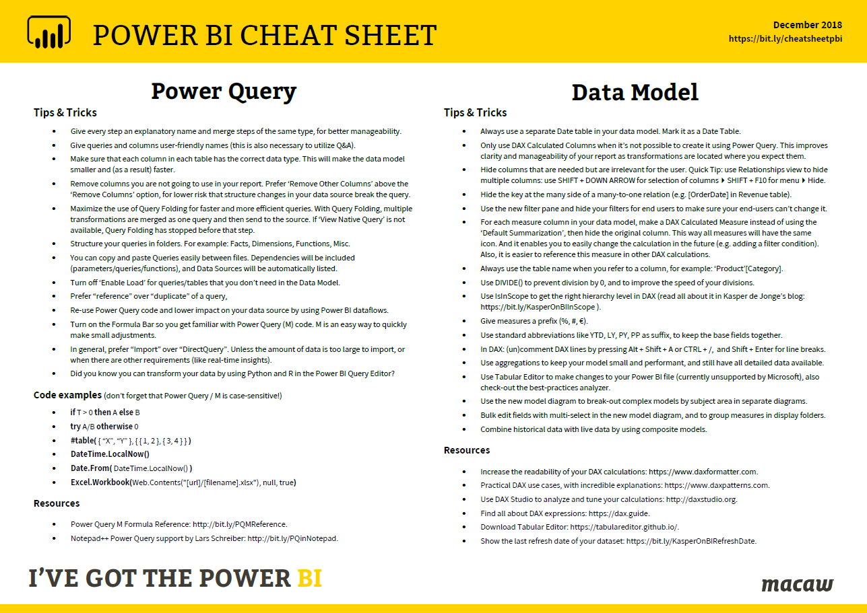
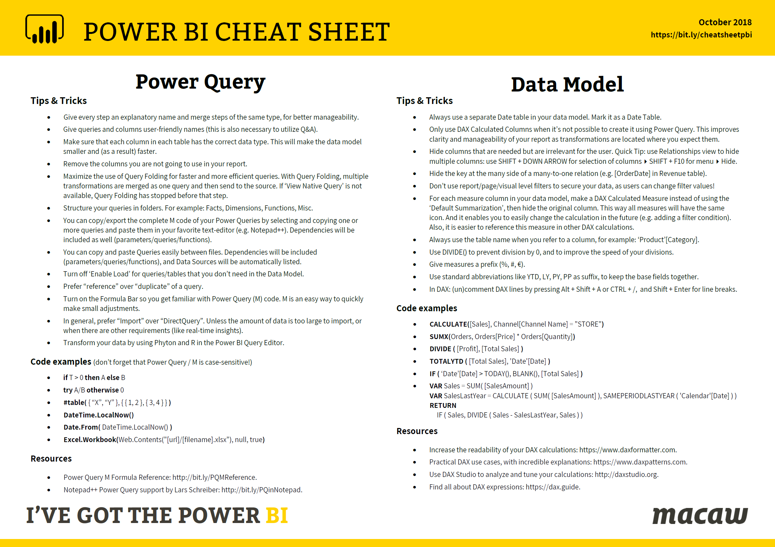

Download for free!
https://bit.ly/cheatsheetpbi

Slide 7
What is... Power BI Premium?

Slide 8
What is Power BI Premium?
Power BI
💎
Power BI Premium
💎
Power BI Premium
💎
Power BI Premium
Customer 1
Customers 1, 2, 3, … n
Customer 2
Customer 3

Slide 9


What is Power BI Premium?
Self-service BI
users
Enterprise BI
All BI users
💎
Azure
Analysis Services
Power BI
Premium
Power BI

Slide 10
What is Power BI Premium?
Flexibility to license by capacity
Greater scale and performance
Dedicated
resources
in the cloud
Power BI Premium
Extending on-premises capabilities
Embedded
analytics

Slide 11
P = Power BI Pro license
Power BI Service
Data Sources
Reports
Dashboards
P
P
P
💎 Premium App Workspace
P
P
P
P
P
P
Data Sources
Reports
Dashboards
💎 Premium App Workspace
Power BI developers
P
P
P
Power BI consumers

Slide 12
Four Power BI Service licenses
Power BI Desktop for report authoring & data exploration
Power BI Free for personal self-service BI
Power BI Pro for sharing and collaboration
Power BI Premium for large scale deployments

Slide 13
What do you get extra?
Share with free users (P1+)
Incremental refresh
48x refresh
Support for larger dataset sizes
XMLA endpoints
Multi-geo
Extra dataflows features (linked entities, parallel execution of transforms, external CDM Folders)
Paginated Reports (SSRS reports)
Ability to embed content in apps on behalf of app users (PaaS)
(now in public preview!)

Slide 14
Demo!
Intro:
Power BI Premium

Slide 15
Specs
Capacity Node | Total v-cores | RAM | DQ/LC (per sec) | Model Refresh Parallelism | Model Size Limit (GB)
EM1 / A1 | 1 | 2,5 | 3,75 | 1 | 1
EM2 / A2 | 2 | 5 | 7,5 | 2 | 1
EM3 / A3 | 4 | 10 | 15 | 3 | 1
P1 / A4 | 8 | 25 | 30 | 6 | 3
P2 / A5 | 16 | 50 | 60 | 12 | 6
P3 / A6 | 32 | 100 | 120 | 24 | 10

Slide 16
Power BI Premium notes
To leverage distribution to ‘Free’ users, use Apps
Access to App Workspaces always require Pro license
You can use Azure Power BI Embedded Capacity, but there is no sharing to ‘Free’ users!

Slide 17
Power BI Premium Incremental refresh

Slide 18
Incremental refresh
Enable large models in Power BI
Faster refresh
More reliable
Lower CPU and Memory usage
Define policy in Power BI Desktop; apply it in the service
Policy doesn’t affect data in Power BI Desktop

Slide 19
XMLA endpoints

Slide 20
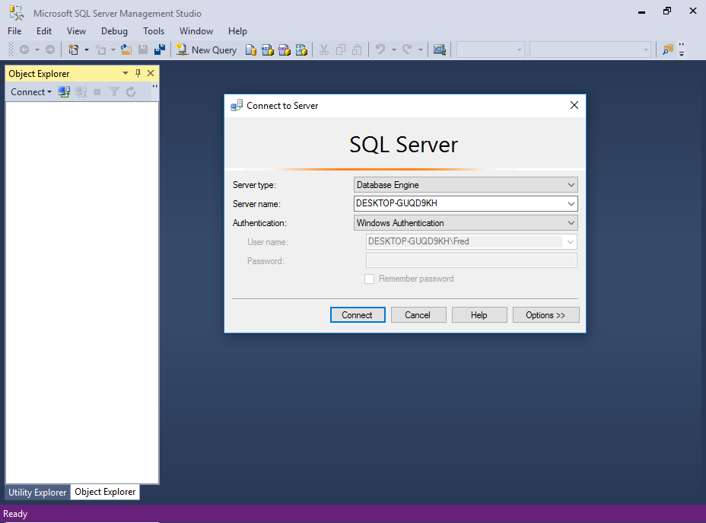
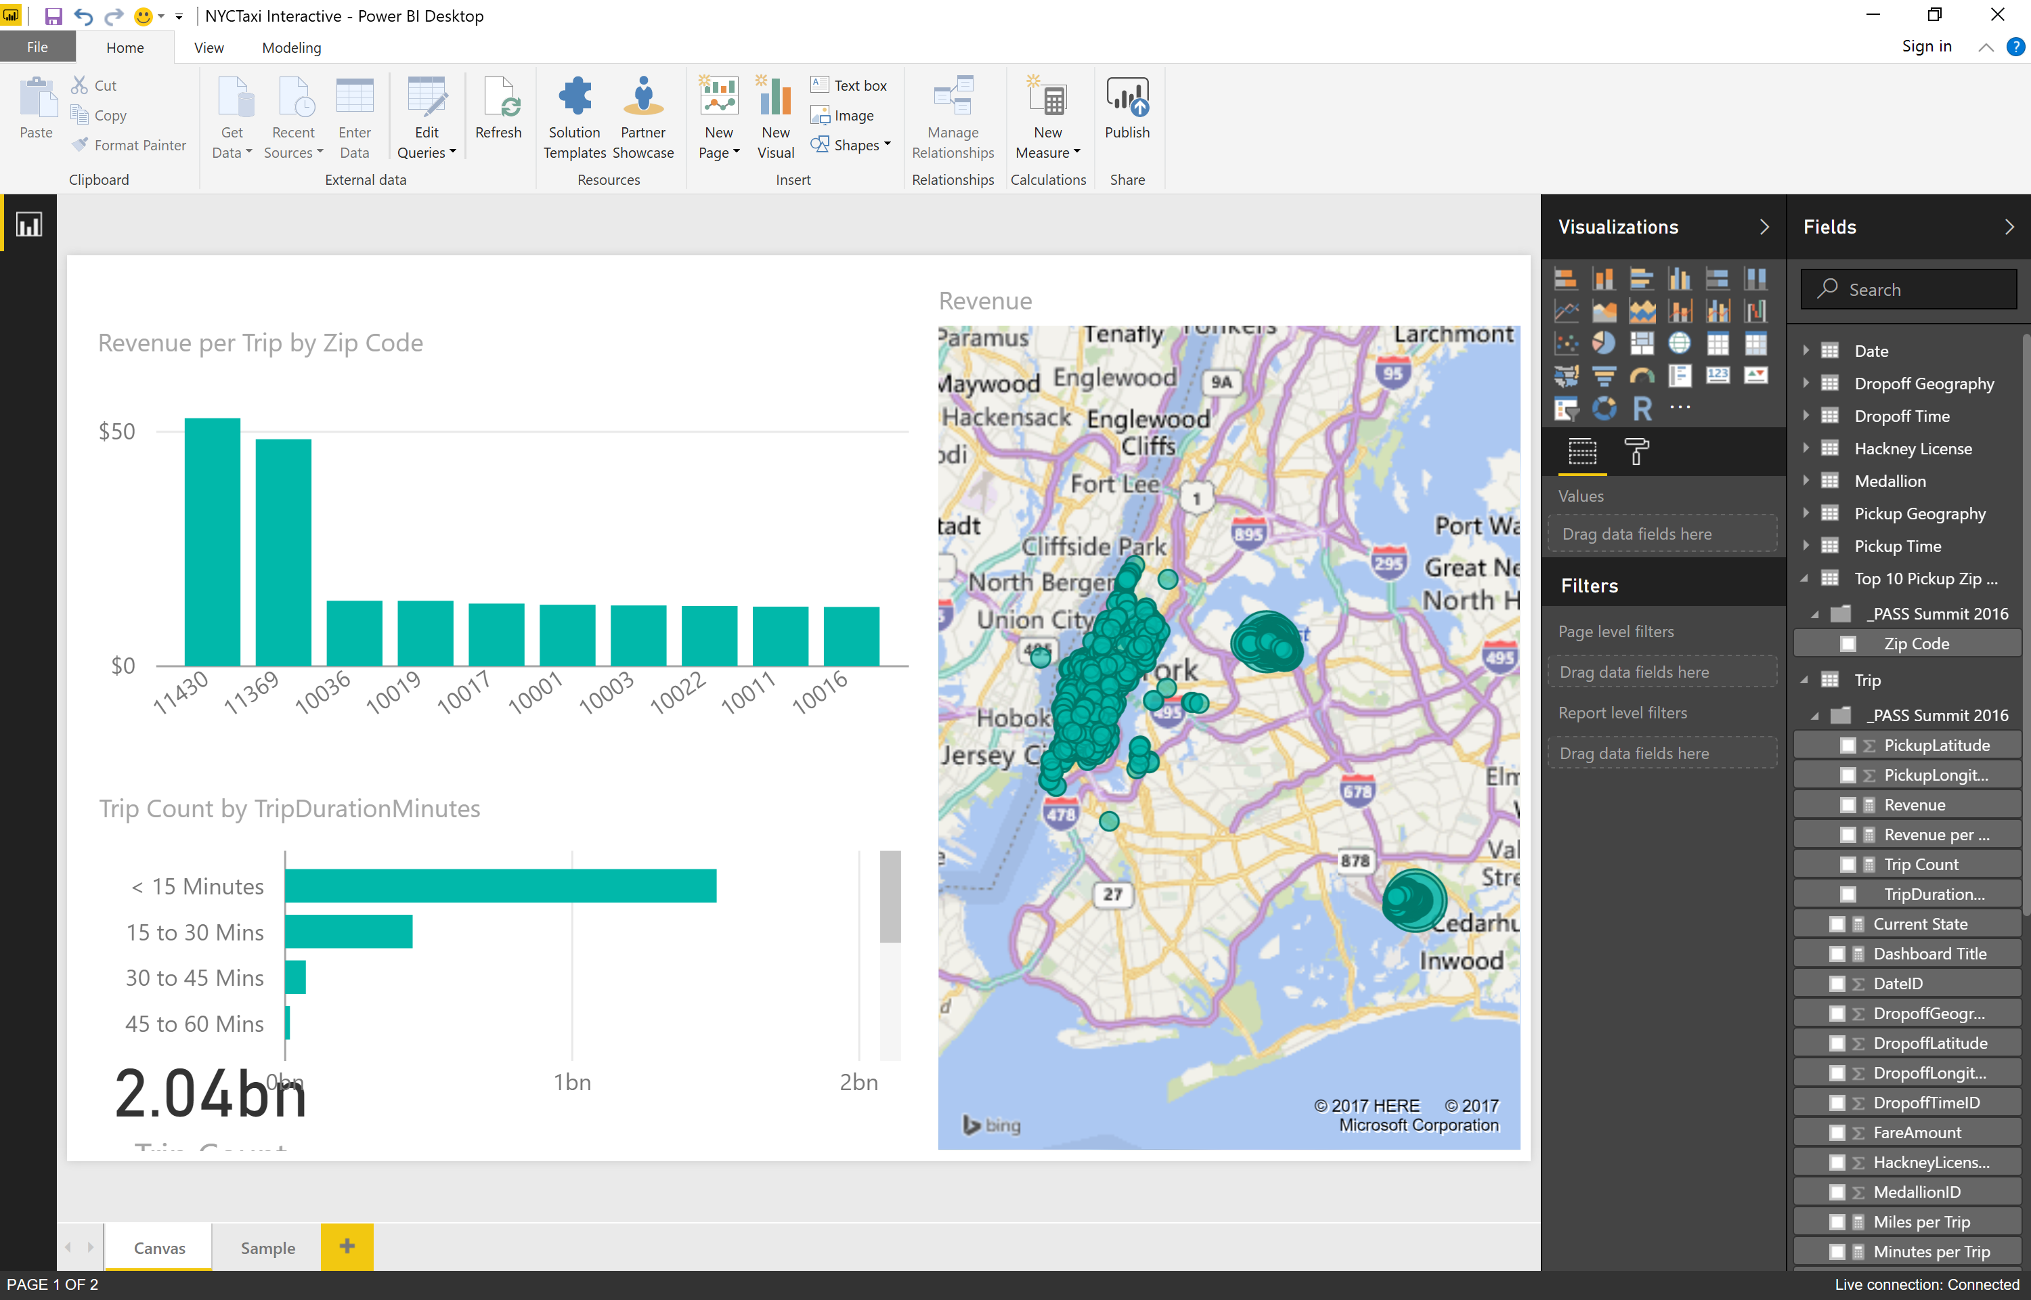

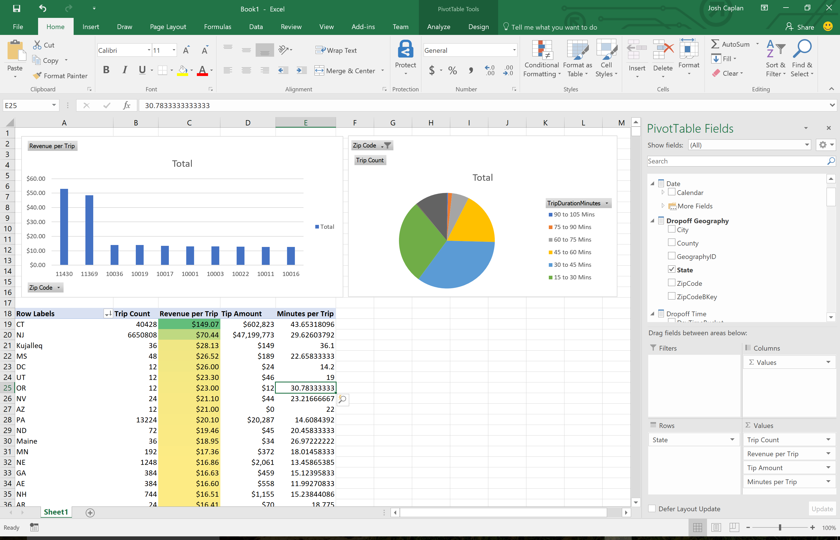
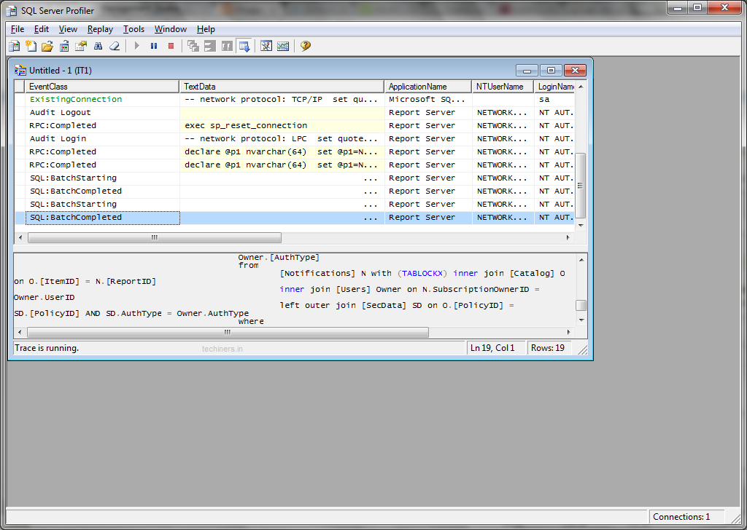
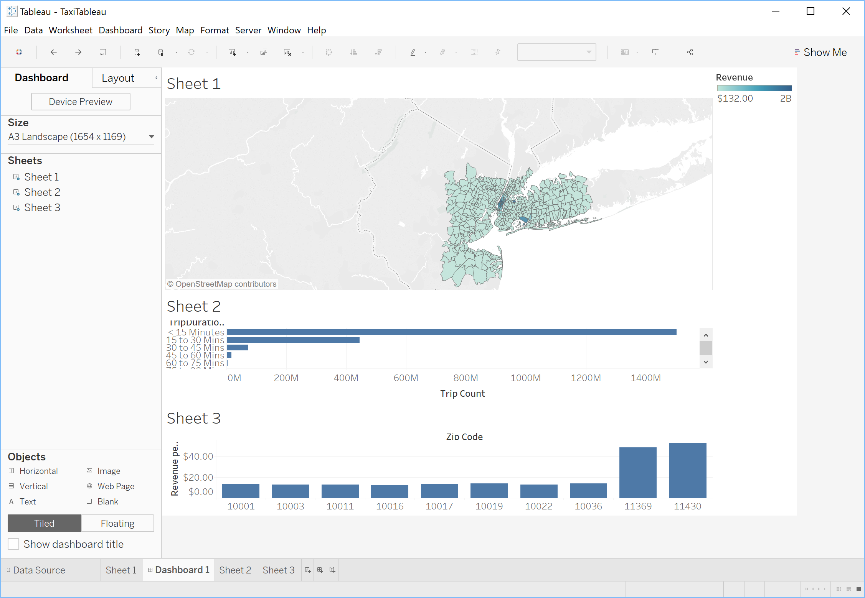
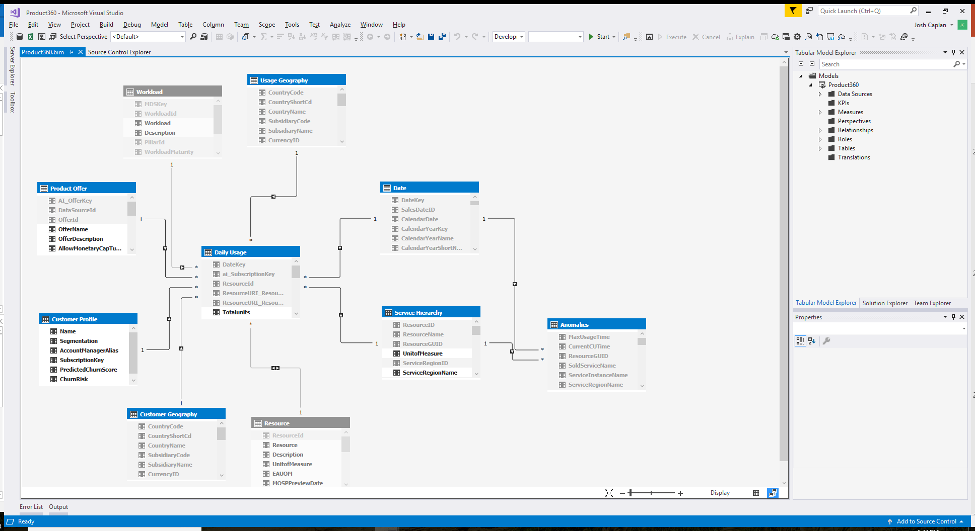
XMLA endpoints
Security
Data modeling
In-memory cache
Azure Analysis Services
Server
Workspace
Lifecycle management
Business logic & metrics

Slide 21
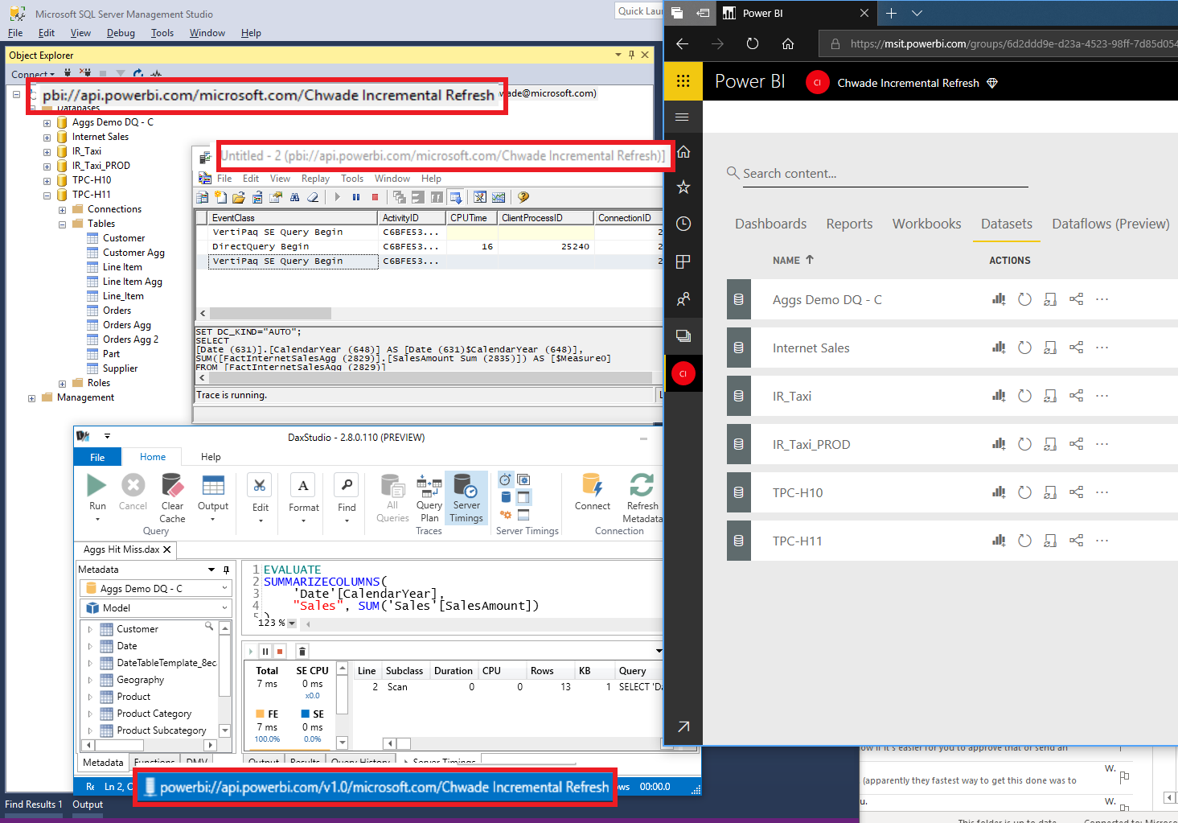

Slide 22
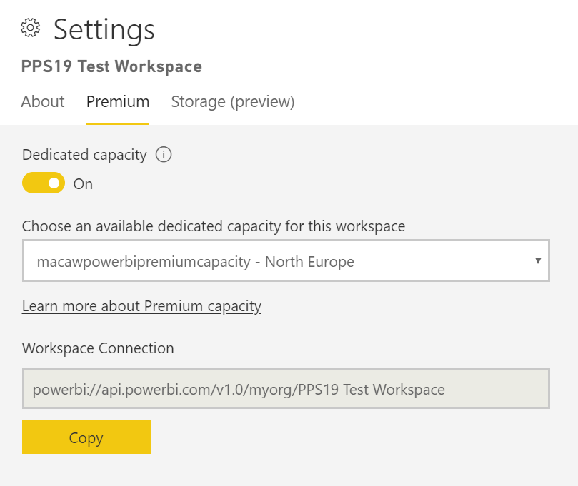

Slide 23
Under the hood of Premium Capacity

Slide 24
Under the hood of Premium capacity
Capacity operations are classified as either interactive or background
Interactive operations include rendering requests and responding to user interactions (filtering, Q&A querying, etc.)
Imported model querying is generally memory resource-intensive
Querying LC/DQ models is generally CPU-intensive
Background operations include dataflow and import model refreshes, and dashboard query caching

Slide 25
Overcommiting the capacity
Each capacity can store many import models (up to 100TB)
When their combined disk storage exceeds the supported memory, then they cannot all be loaded into memory at the same time and the capacity is overcommitted

Slide 26
Evictions from memory (1)
If the capacity is not experiencing any memory pressure, models are simply loaded into memory and remain there
When insufficient memory is available to load a model, the Power BI service will first need to free up memory
The removal of a model from memory is known as eviction

Slide 27
Evictions from memory (2)
Power BI will first try to detecting models that have become inactive by seeking models which have not been used in the last three minutes
If there are no inactive models to evict, the Power BI service seeks to evict models loaded for background operations
A last resort, after 30 seconds of failed attempts, is to fail the interactive operation of the current user

Slide 28
Evictions from memory (3)
Dataset eviction
==
normal and expected behavior

Slide 29
Dataset refreshes
Dataset refreshes are memory intensive and use ±2x RAM
Scheduled dataset refresh will be queued if there is insufficient memory and all models are active (no evictions possible)
On-demand refreshes (triggered by a user request or API call) will retry three times, and then fail if there are still not enough resources

Slide 30
Under the hood of Premium capacity
Capacity: P1
Backend v-cores: 4
Memory: 25 GB
Storage: 100 TB
25 GB Memory
100 TB storage
Dataset 1
Dataset 2
Dataset 3
Dataset 4
Dataset 5
Dataset 6
Dataset 7
Dataset 8
Dataset 9
Dataset 10
Dataset 11
Dataset 12
Dataset 13
Dataset 14

Slide 31
Under the hood of Premium capacity
Capacity: P1
Backend v-cores: 4
Memory: 25 GB
Storage: 100 TB
25 GB Memory
Temperature: Cool
Dataset 1
Dataset 2
Dataset 3
100 TB storage
Dataset 1
Dataset 2
Dataset 3
Dataset 4
Dataset 5
Dataset 6
Dataset 7
Dataset 8
Dataset 9
Dataset 10
Dataset 11
Dataset 12
Dataset 13
Dataset 14

Slide 32
What happens when the capacity is out of resources…

Slide 33
Eviction
Capacity: P1
Backend v-cores: 4
Memory: 25 GB
Storage: 100 TB
25 GB Memory
Dataset 1
Dataset 2
Dataset 3
Dataset 4
Dataset 5
Dataset 6
Temperature: Warm
100 TB storage
Dataset 1
Dataset 2
Dataset 3
Dataset 4
Dataset 5
Dataset 6
Dataset 7
Dataset 7
Dataset 8
Dataset 9
Dataset 10
Dataset 11
Dataset 12
Dataset 13
Dataset 14

Slide 34

How many refreshes at one time?
Capacity: P1
Backend v-cores: 4
Memory: 25 GB
Storage: 100 TB
25 GB Memory
Dataset 1
Dataset 2
Dataset 3
Dataset 4
Dataset 5
Dataset 6
Queue
100 TB storage
Dataset 1
Dataset 2
Dataset 3
Dataset 4
Dataset 5
Dataset 6
Dataset 7
Dataset 7
Dataset 8
Dataset 9
Dataset 10
Dataset 11
Dataset 12
Dataset 13
Dataset 14

Slide 35
How many refreshes at one time?
Capacity: P1
Backend v-cores: 4
Memory: 25 GB
Storage: 100 TB
25 GB Memory
Temperature: Warm
Dataset 1
Dataset 2
Dataset 3
Dataset 4
Dataset 5
Dataset 6
Queue
100 TB storage
Dataset 7
Dataset 1
Dataset 2
Dataset 3
Dataset 4
Dataset 5
Dataset 6
Dataset 7
Dataset 8
Dataset 9
Dataset 10
Dataset 11
Dataset 12
Dataset 13
Dataset 14

Slide 36
What if my capacity is heavily used…

Slide 37

Background vs interactive operations..
Capacity: P1
Backend v-cores: 4
Memory: 25 GB
Storage: 100 TB
25 GB Memory
Temperature: Hot
Dataset 1
Dataset 2
Dataset 3
Dataset 4
Dataset 5
Dataset 6
Queue
100 TB storage
Dataset 1
Dataset 2
Dataset 3
Dataset 4
Dataset 5
Dataset 6
Dataset 7
Dataset 7
Dataset 8
Dataset 9
Dataset 10
Dataset 11
Dataset 12
Dataset 13
Dataset 14

Slide 38
All interactive operations…
Capacity: P1
Backend v-cores: 4
Memory: 25 GB
Storage: 100 TB
25 GB Memory
Temperature: Burning
Dataset 1
Dataset 2
Dataset 3
Dataset 4
Dataset 5
Dataset 6
Queue
100 TB storage
Dataset 8
Dataset 9
Dataset 1
Dataset 2
Dataset 3
Dataset 4
Dataset 5
Dataset 6
Dataset 7
Dataset 7
Dataset 10
Dataset 8
Dataset 9
Dataset 10
Dataset 11
Dataset 12
Dataset 13
Dataset 14

Slide 39
Power BI Premium Management

Slide 40
Power BI Premium Management
Creating and Managing Capacities
Assigning Workspaces to Capacities
Monitoring Capacities
Optimizing Premium Capacities

Slide 41
Creating and Managing Capacities
The Capacity Settings page of the Power BI Admin Portal displays the number of v-cores purchased and available (i.e. yet to be assigned to a capacity)
Each capacity has its won set of admins
Capacity Admins cannot access workspace content
A Premium capacity can be assigned to a region other than the home region of the Power BI tenant (multi-geo)
You can specify the memory per workload (default stuff, dataflows, paginated reports)

Slide 42
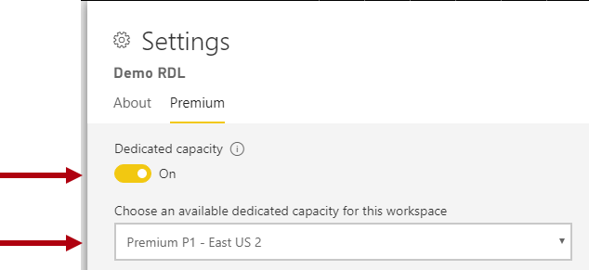
Assigning Workspaces to Capacities
Assign workspaces manually
Bulk assign:
Workspaces by users
Specific workspaces
The entire organization's workspaces

Slide 43
Monitoring Capacities
Power BI Admin Portal (basic)
Power BI Premium Capacity Metrics App, including:
Average CPU and high utilization count
Average Memory and high utilization count, and memory usage for specific datasets, dataflows and paginated reports
Active datasets loaded in memory
Average and maximum query durations
Average query wait times
Average dataset and dataflow refresh times

Slide 44
Demo!
Monitoring Premium capacity

Slide 45
Optimizing Premium Capacities
Separate business critical and Self-Service BI (SSBI) into different capacities
Check if sharing is only with Power BI Pro users, there may be no need to store content in Premium capacity
Use Premium when looking to achieve a specific refresh time
Use Premium when specific features are required, for example large datasets or paginated reporting
Optimize your Data Models

Slide 46
Sizing your capacities
Model size and data characteristics
Concurrent active models
Import model refresh
Concurrent queries
Other workloads: dataflows and paginated reports
Priority (business-critical vs self-service)
Generally, for larger models you scale up, for more concurrency you scale out
Consider splitting a P2, before upgrading to P3
Test the waters using Azure Power BI Embedded Capacity

Slide 47
Power BI Premium or Azure Analysis Services

Slide 48


Power BI Premium or Azure Analysis Services
Power BI Premium 💎
Policy-based incremental refresh
Scheduled refresh
Composite models & aggregations
More connectors
PBI Desktop
…
Power BI
Analysis Services
Azure Analysis Services

Slide 49

Power BI Premium or Azure Analysis Services
*State of March 2019*
DevOps experience
Killer features (Object Level Security / Translations / Composit Model)
One model “to rule them all”
Version control
Data Source Connectivity
Front-end tooling
Very large model support
User group characteristics

Slide 50
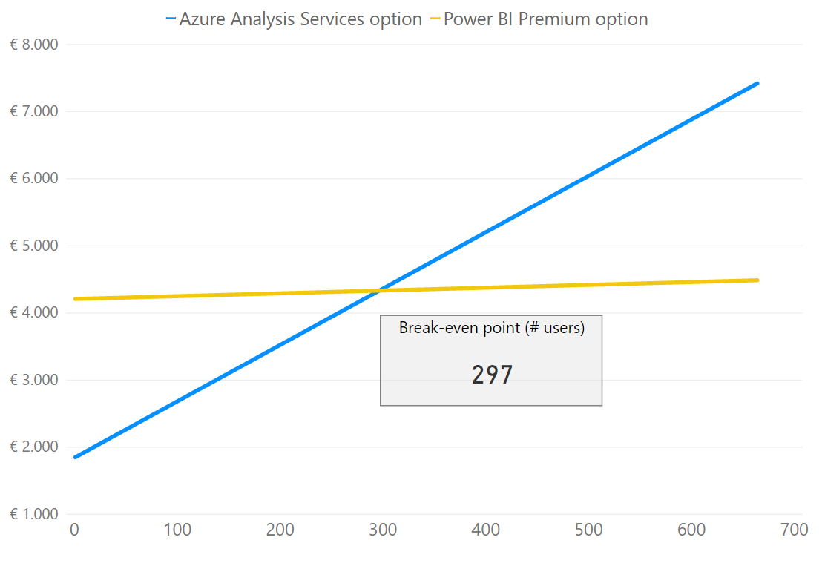
Power BI Premium vs Azure Analysis Services
Premium💎scenario
1x P1 license = €4.200
5% of users are also creators and need a Pro licence (€8,40)
Analysis Services scenario
DevTest = 1x S1 during working hours
Prod = 1x S1 24/7, with S2 upscale on peak hours and processing windows
Each user requires a Pro licence

Slide 51
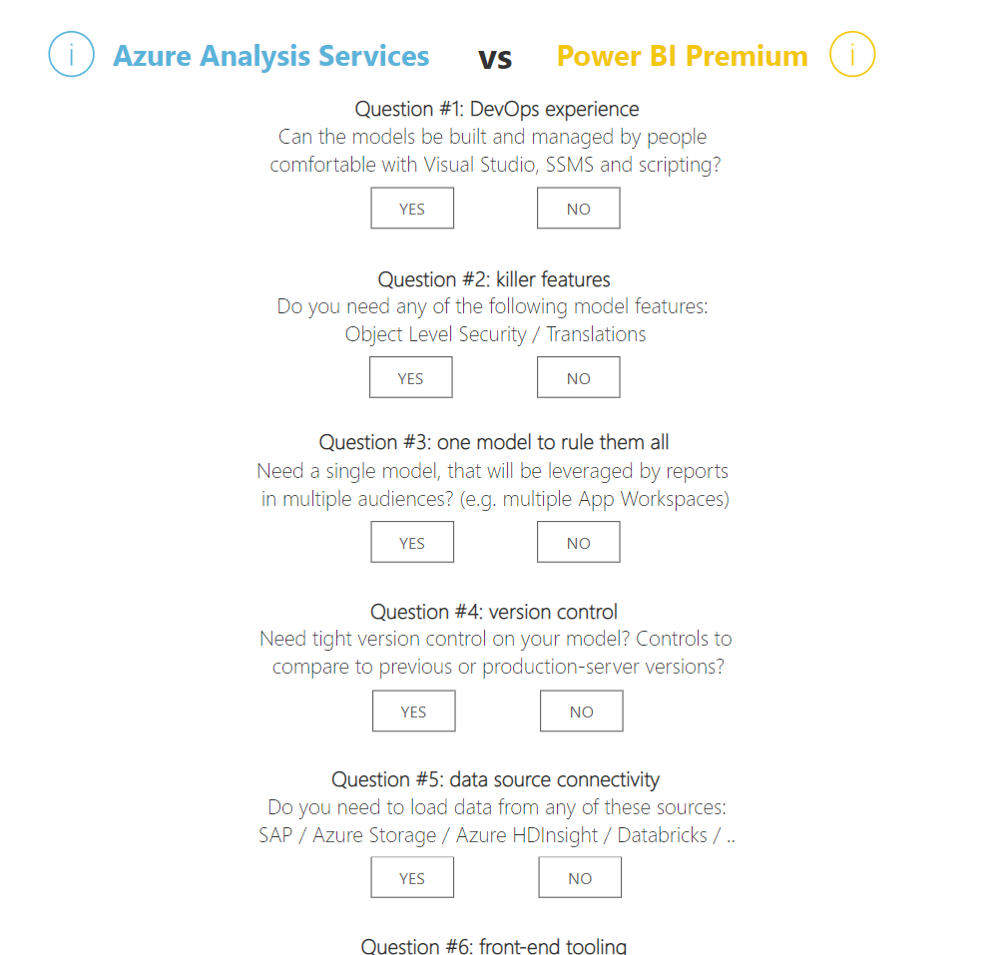
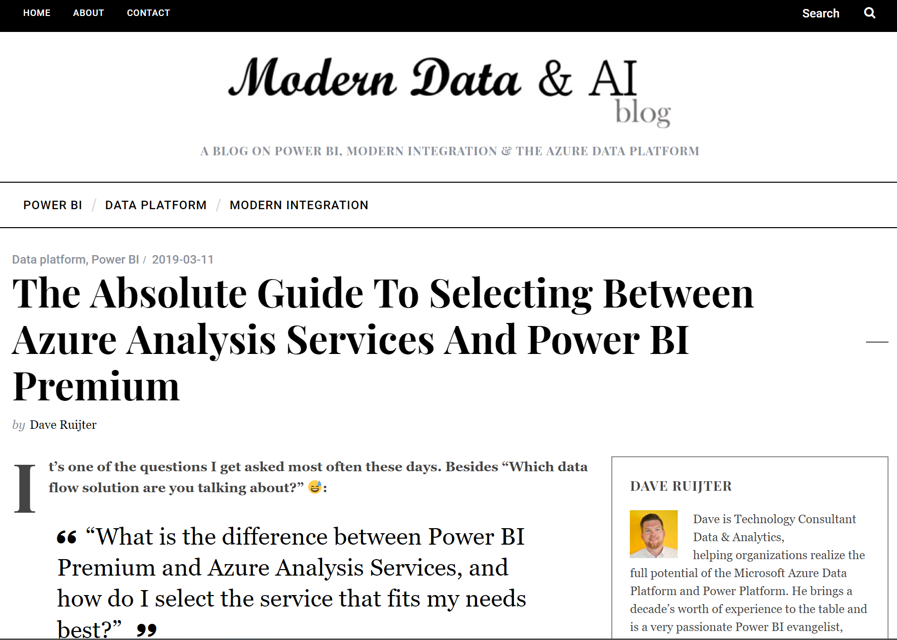
Power BI Premium vs Azure Analysis Services
https://www.moderndata.ai/aasvspbi

Slide 52
Power BI Premium AI features

Slide 53
AI features in Power BI Premium
Invoke Cognitive Services to enrich your data
Create new Machine Learning models with AutoML
Easily invoke your Azure Machine Learning models (premium not required)

Slide 54
Demo!
Power BI Premium AI features

Slide 55
Roadmap for Power BI Premium
Calculation Groups
XMLA endpoints write-enabled
Paginated Reports GAA

Slide 56
Session resources
My blog post on selecting between Power BI Premium and Azure Analysis Services:
Power BI Premium on public Microsoft sites:
Premium documentation: https://docs.microsoft.com/en-us/power-bi/service-premium
Premium whitepaper: https://docs.microsoft.com/en-us/power-bi/whitepaper-powerbi-premium-deployment
Premium roadmap / release notes:
Premium on Power BI Ideas:

Slide 57
Download for free!
https://bit.ly/cheatsheetpbi

